Slide 1

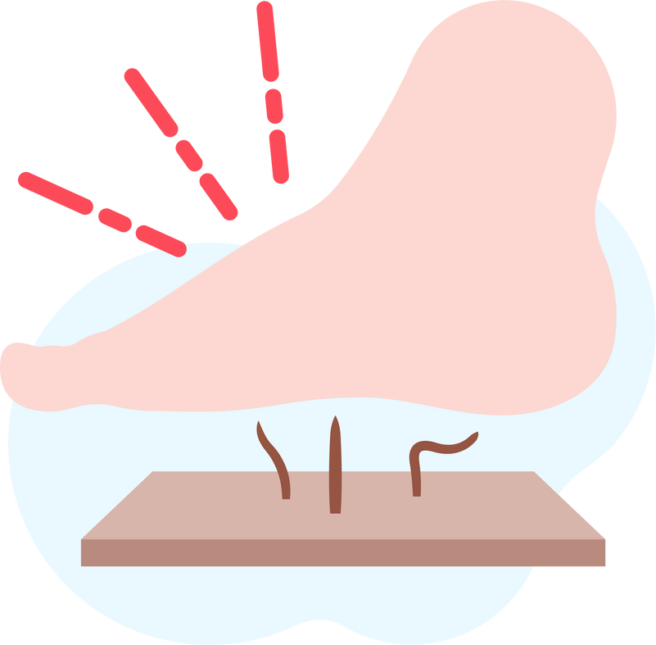
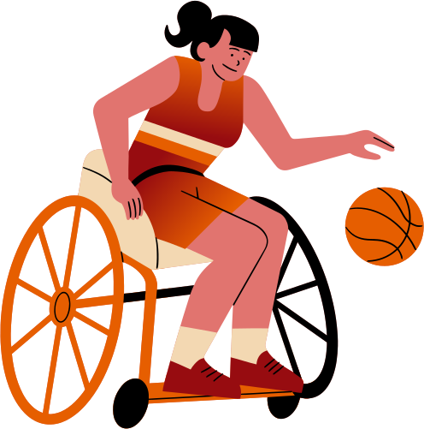


Lightning Talk 6:
Contextualization/
Check-in
PRESSURE SENSOR PATCH
sdmay25-12
Advisor: Santosh Pandey
Client: BAE Systems

Slide 2
Project Overview
Target Users
Design Summary
Current Status
Goal
Our system includes a mat with arrays of pressure load cells, a microcontroller for data processing, and an Android app that currently connects via WiFi (WebSocket) for the prototype, with plans to use Bluetooth in the final product.
Develop a pressure sensor patch for adaptive sports athletes to monitor pressure levels and prevent pressure sores.
Athletes with traumatic injuries at risk of pressure sores
Developed initial wireframes for the app and working on WiFi-based data transmission from the mat to the Android app using WebSocket.

Slide 3
Artifact - Journey Map
Reflection:
This journey emphasizes ease of use and unobtrusive support for users, aligning well with user needs for seamless pressure monitoring.
Setup - User place the pressure mat on the recreational equipment (kayak seating, bike seat)
Step 1
Real-Time Monitoring - App displays live pressure reading received over WiFi (Bluetooth for Final Product)
Step 2
Alert - App notifies user/caregiver & the mat vibrates/produce sound to adjust position if pressure exceeds a threshold.
Step 3

Slide 4
Artifact - Pros & Cons
Pros | Cons
Provides real-time feedback, reducing risk of pressure sores | WiFi connection causes the used mobile app to be disconnected from the Internet.
WiFi/WebSocket connection enable reliable data transfer to the app | Battery usage may be higher with continuous WiFi communication.
Affordable compared to similar medical-grade solutions | Mitigation: Exploring energy-saving modes for WiFi and planning for Bluetooth in the final product for improved portability and energy efficiency.

Slide 5
Artifact - Technical Complexity Analysis
Internal Complexity
  Data from multiple pressure points requires aggregation and efficient processing
  WebSocket communication handles WiFi signals in the prototype, with future complexity in shifting to Bluetooth.
External Complexity
  Designing a user-friendly app interface that provides essential feedback without overwhelming the user
  Ensuring the durability and comfort in the mat design for real-world usage.

Slide 6
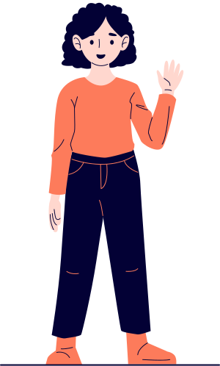
Reflection on Design Suitability
Human Suitability:
Current Solution:
App interface and pressure sensor design are tailored to meet the needs of adaptive sports athletes and other users at risk for pressure sores.
Potential Improvement:
Adding personalized alert settings to enhance usability for different activity levels.

Slide 7

Reflection on Design Suitability
Economic Suitability:
Improvement Over Existing Solutions:
More affordable than current clinical pressure-sensing solutions, accessible for everyday users.
Drawbacks:
Prototype limitations with WiFi range and energy efficiency.
Mitigation:
Bluetooth integration in the final product to increase portability and reduce power consumption.

Slide 8

Reflection on Design Suitability
Technical Suitability:
Complexity Justification:
Integration of pressure sensors, microcontrollers, and WebSocket communication for WiFi is technically challenging but effectively meets real-time monitoring needs.
Expertise Showcase:
Demonstrates skills in embedded systems, network communication and user-centered design, with plans for Bluetooth integration

Slide 9

Conclusion & Next Steps
Key Takeaway:
Our design combines affordability, usability, and technical sophistication, with WiFi in the prototype and Bluetooth planned for the end product.
Upcoming Milestones:
  Finalize an array prototype to develop it into pressure sensor mat form.
  Work on the main dashboard of the application for the real-time data transfer from the pressure sensor.

